Slide 1
ASP.net Validation

Slide 2

Background
If we are assuming that the user will enter all data in expected form then it’s a wrong assumption.
It’s always better to validate the user input before accepting to the system.

Slide 3
Introduction
A Validation server control is used to validate the data of an input control. If the data does not pass validation, it will display an error message to the user.
Syntax :
  <asp:control_name id="some_id" runat="server" />

Slide 4
Client side Vs Server side
We can validate the user input from client-side and or server-side.
if we just wanted to validate the user input only in client-side then we can use JavaScript or any other scripting languages.
It's always advised to to do validations in server side also.

Slide 5
Why Server Validation ?
Because client side validation is based on client platform and browser type.
We may not be able to execute client side validation every time so as a back up always server side validation is required.

Slide 6
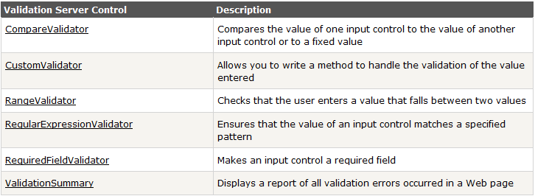
Available Controls

Slide 7
The Validation Process
When using automatic validation, the user receives a normal page and begins to fill in the input controls.
When finished, the user clicks a button to submit the page. Every button has a CausesValidation property, which can be set to true or false.

Slide 8
CauseValidation
CausesValidation is false
  ASP.NET will ignore the validation controls.
CausesValidation is true (the default):
  ASP.NET will automatically validate the page when the user clicks the button. It does this by performing the validation for each control on the page. If any control fails to validate, ASP.NET will return the page with some error information

Slide 9
Cont
In browsers that support it, ASP.NET will automatically add code for client-side validation.
In this case, when the user clicks a CausesValidation button, the same error messages will appear without the page needing to be submitted and returned from the server.

Slide 10
The BaseValidator Class
The validation control classes are found in the System.Web.UI.WebControls namespace and inherit from the BaseValidator class.
This class defines the basic functionality for a validation control.

Slide 11
BaseValidator Members
ControlToValidate : Indicates the input control to validate.
EnableClientScript : A Boolean property that specifies whether the client-side validation will take place. It is true by default.

Slide 12
Cont
Enabled : A Boolean property that allows the user to enable or disable the validator.
ErrorMessage : Error string that will be shown in the errors summary by the Validation-Summary control, if present.
Text : The error text that will be displayed in the validator control if the attached input control fails its validation.

Slide 13
IsValid : This property is also usually read or set only from script code (or the code-behind class) to determine whether the associated input control’s value is valid.
SetFocusOnError : Auomatically set focus to control which is not validated.
ValidationGroup.

Slide 14
Text and ErrorMessage
When Text property is set with some message, this message is displayed in the validation control when validation fails. If this property is not set, the text specified in the ErrorMessage property is displayed in the control.
The ErrorMessage property is commonly used to provide different messages for the validation control and the ValidationSummary control.

Slide 15
RequiredFieldValidator
The simplest available control is RequiredFieldValidator, whose only work is to ensure that the associated control is not empty.
For example, the control will fail validation if a linked text box doesn’t contain any content (or just contains spaces)

Slide 16
RangeValidator
The RangeValidator control verifies that an input value falls within a predetermined range.
It has three specific properties: MinimumValue, MaximumValue, and Type.
The Type property defines the type of the data that will be typed into the input control and validated. The supported values are Currency, Date, Double, Integer, and String.

Slide 17
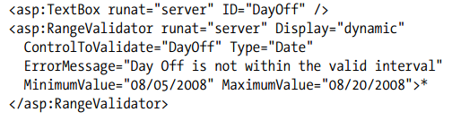
Example

Slide 18
CompareValidator
The CompareValidator control compares a value in one control with a fixed value or, more commonly, a value in another control. For example, this allows you to check that two text boxes have the same data.
It also exposes the ValueToCompare and ControlToCompare properties, which allow you to compare the value of the input control with a constant value or the value of another input control

Slide 19
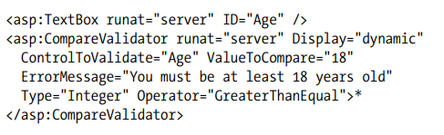
Example

Slide 20
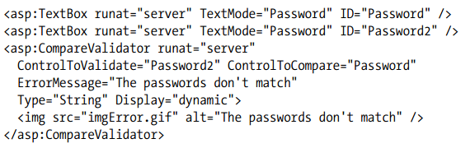
Example

Slide 21
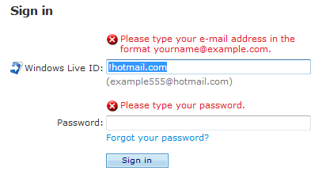
Placing image as validation error

Slide 22
RegularExpression
It allows you to validate text by matching against a pattern defined in a regular expression.
You simply need to set the regular expression in the ValidationExpression property.

Slide 23
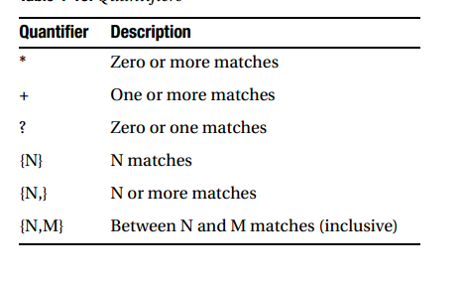
Regular Expression

Slide 24
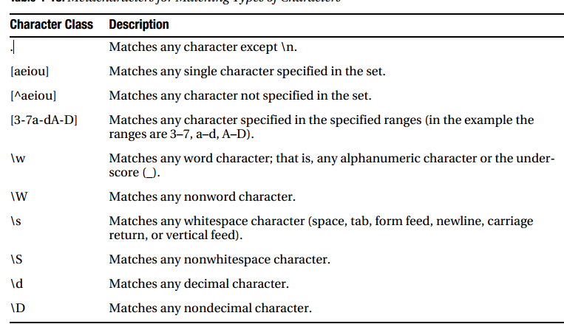
Regular Expression

Slide 25
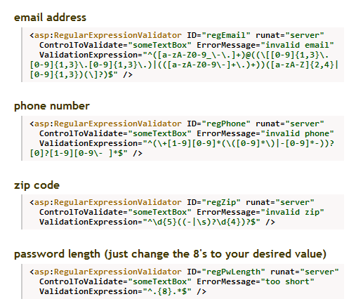
Regular Expression

Slide 26
CustomValidator Control
If none of the other validators can help you, the CustomValidator usually can.
It doesn't come with a predefined way of working; you write the code for validating your self.

Slide 27
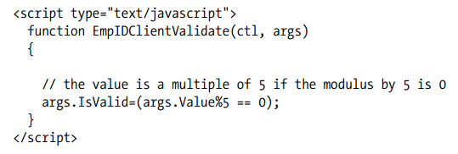
Client side Validation example

Slide 28
Validation Summary Control

Slide 29
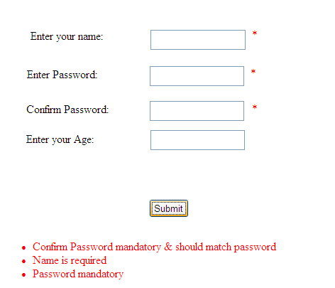
Example

Slide 30
Validation Groups
Validation groups allow you to organize validation controls on a page as a set.
Each validation group can perform validation independently from other validation groups on the page.

Slide 31
Cont
You create a validation group by setting the ValidationGroup property to the same name (a string) for all the controls you want to group. You can assign any name to a validation group, but you must use the same name for all members of the group.

Slide 32
ValidationGroup Property
Specifies the name of the validation group to which this validation control belongs.

Slide 33
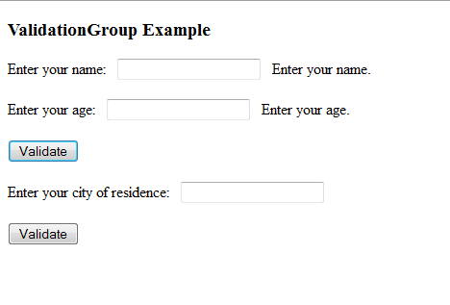
Example

Slide 34
Thank you

